Slide 1
ENERGY STAR
Prepared by Tovia Bat-Leah for QE calibration meeting 01/12/11

Slide 2
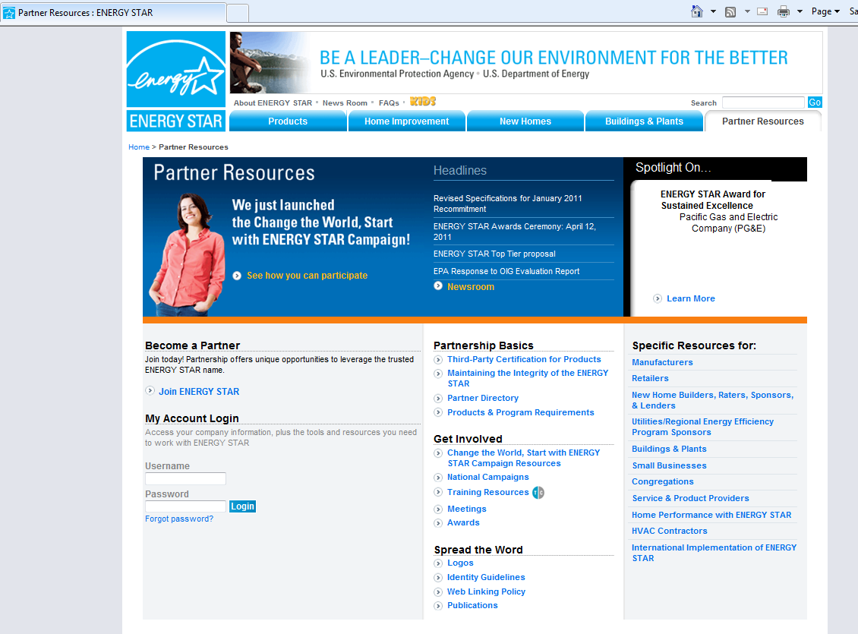
Energy Star EPA web site

Slide 3
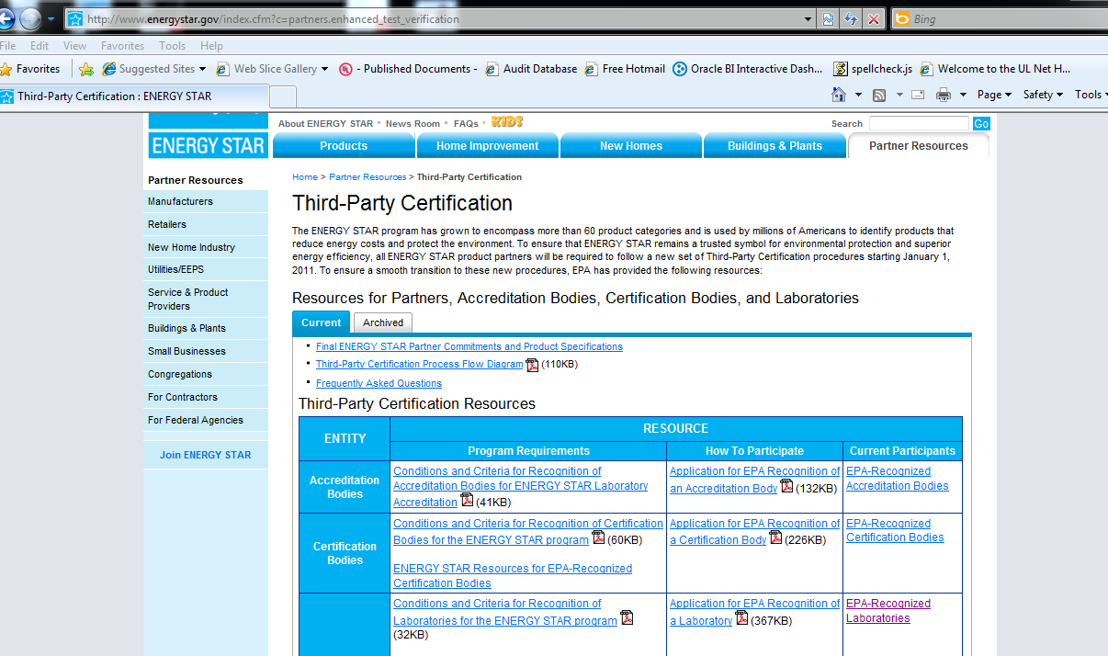

Slide 4
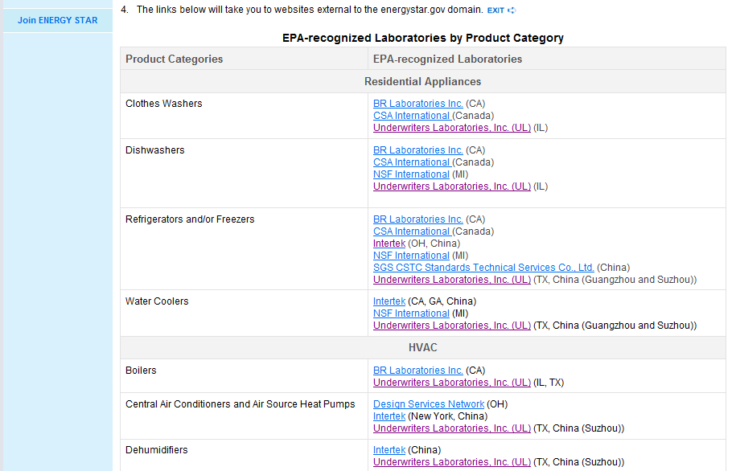


Slide 5
Conditions and Criteria for Recognition of Laboratories for the ENERGY STAR® Program
General Requirements:
1) Maintain accreditation to ISO/IEC 17025, “General requirements for the competence of testing and calibration laboratories,” by an EPA-recognized Accreditation Body (AB).

Slide 6
Conditions and Criteria for Recognition of Laboratories for the ENERGY STAR® Program
Inter-laboratory Comparison Testing:
1) Agree to participate in relevant and available inter-laboratory comparison testing (ILC) when EPA/DOE deems it necessary.
2) Carry out ILC in accordance with normal testing/calibration and reporting procedures, unless otherwise specified in the instructions from the proficiency test provider

Slide 7
Conditions and Criteria for Recognition of Laboratories for the ENERGY STAR® Program
Reporting:
1) Submit to EPA a digital copy of the accreditation certificate and scope of accreditation. This shall include at a minimum:
Accreditation effective date;
Accreditation expiration date (if applicable); and,
ENERGY STAR-relevant accredited test methods.

Slide 8
Conditions and Criteria for Recognition of Laboratories for the ENERGY STAR® Program
2) Authorize the laboratory’s AB to share with EPA copies of assessment documentation related to ENERGY STAR testing, including corrective action plans and deficiency resolutions.

Slide 9
Conditions and Criteria for Recognition of Laboratories for the ENERGY STAR® Program
3) Report to both EPA and the laboratory’s AB within 30 days of any major changes that affect the laboratory’s:
Legal, commercial, organizational, or ownership status;
Organization and management, e.g., key managerial staff;
Policies or procedures, where appropriate;
Location;
Personnel, facilities, working environment or other resources, where significant; and,
Other such matters that may affect the laboratory's capability, scope of recognized activities, or compliance with the ENERGY STAR requirements and relevant technical documents.

Slide 10
Conditions and Criteria for Recognition of Laboratories for the ENERGY STAR® Program
4) Forward any questions related to ENERGY STAR test methods to EPA for resolution, and abide by the decisions of EPA relative to the resolution of those questions

Slide 11
END

